Slide 1


#WiDS2020

Slide 2
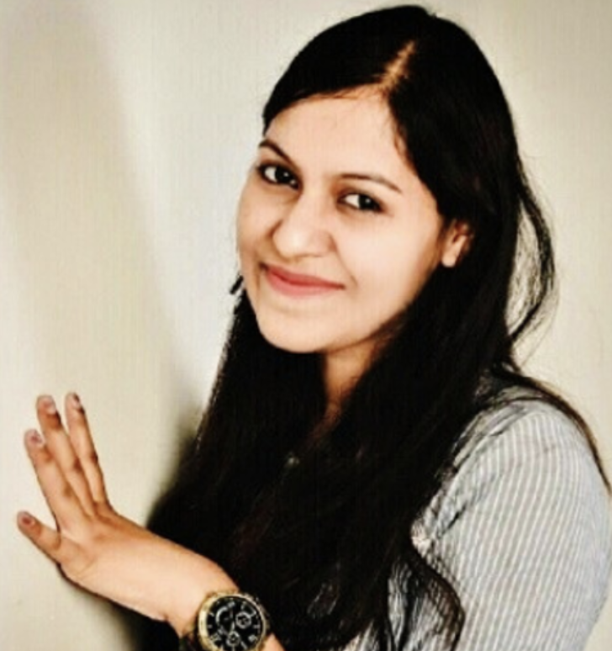
Language models and its Implications in scaling NLP Research
Chirasmita Mallick
Principal Data Scientist, G2

Slide 3
NLP is going to be the most transformational tech of the decade

Slide 4
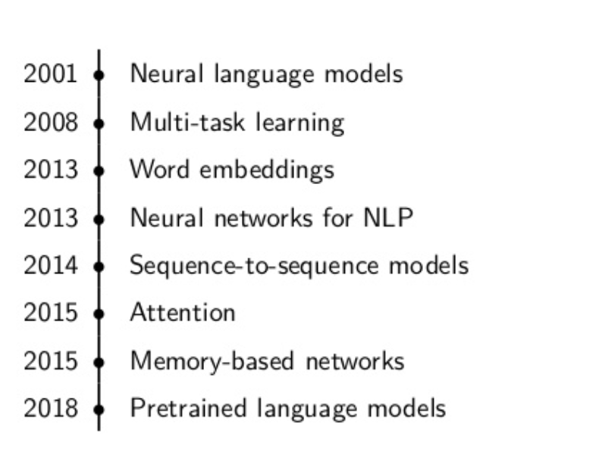
History of Language Models

Slide 5
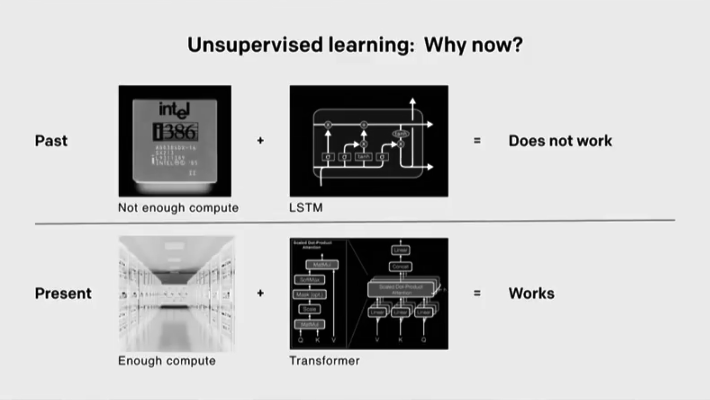
Rise in Success of Unsupervised Learning

Slide 6
Unsupervised Supremacy
At the end of the day, We want to build systems that can utilize all the data that is available to us .
RL systems make use of reward signals only.
Supervised Learning scaled faster too
Now, The same is happening with unsupervised learning

Slide 7
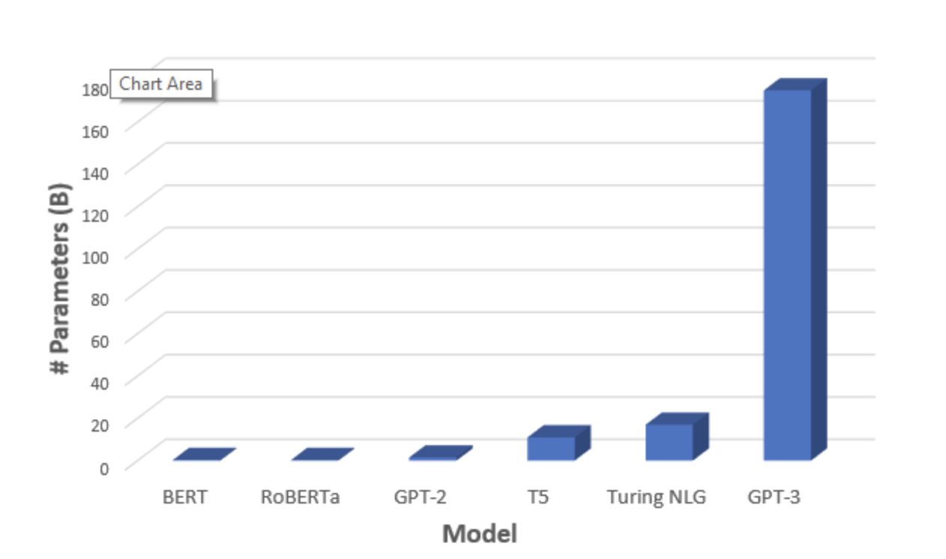
Comparison of Language Models

Slide 8
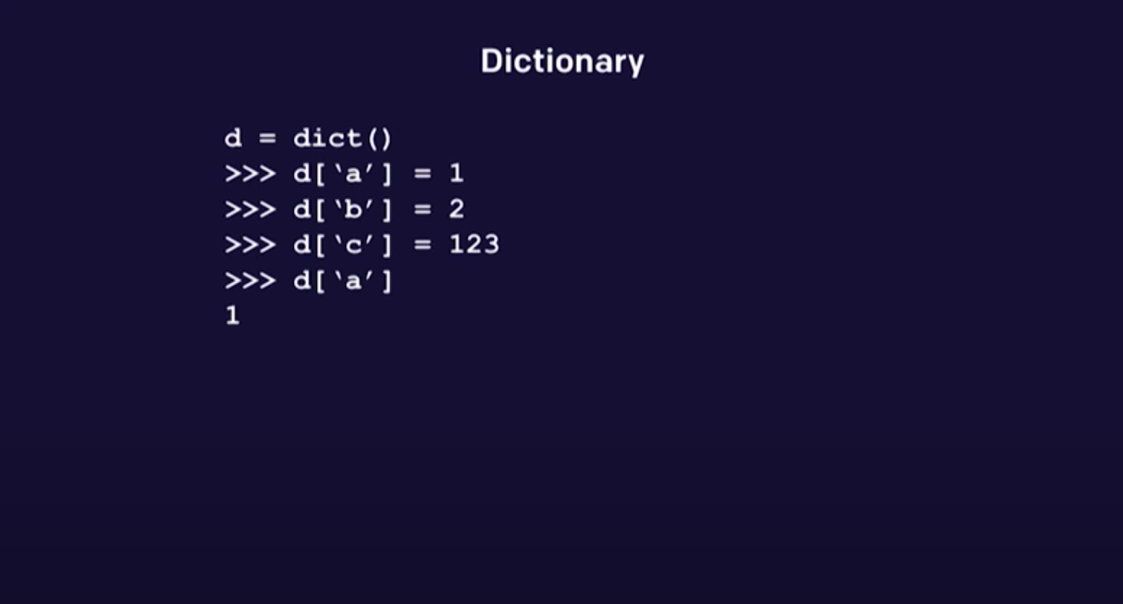
Attention Models

Slide 9
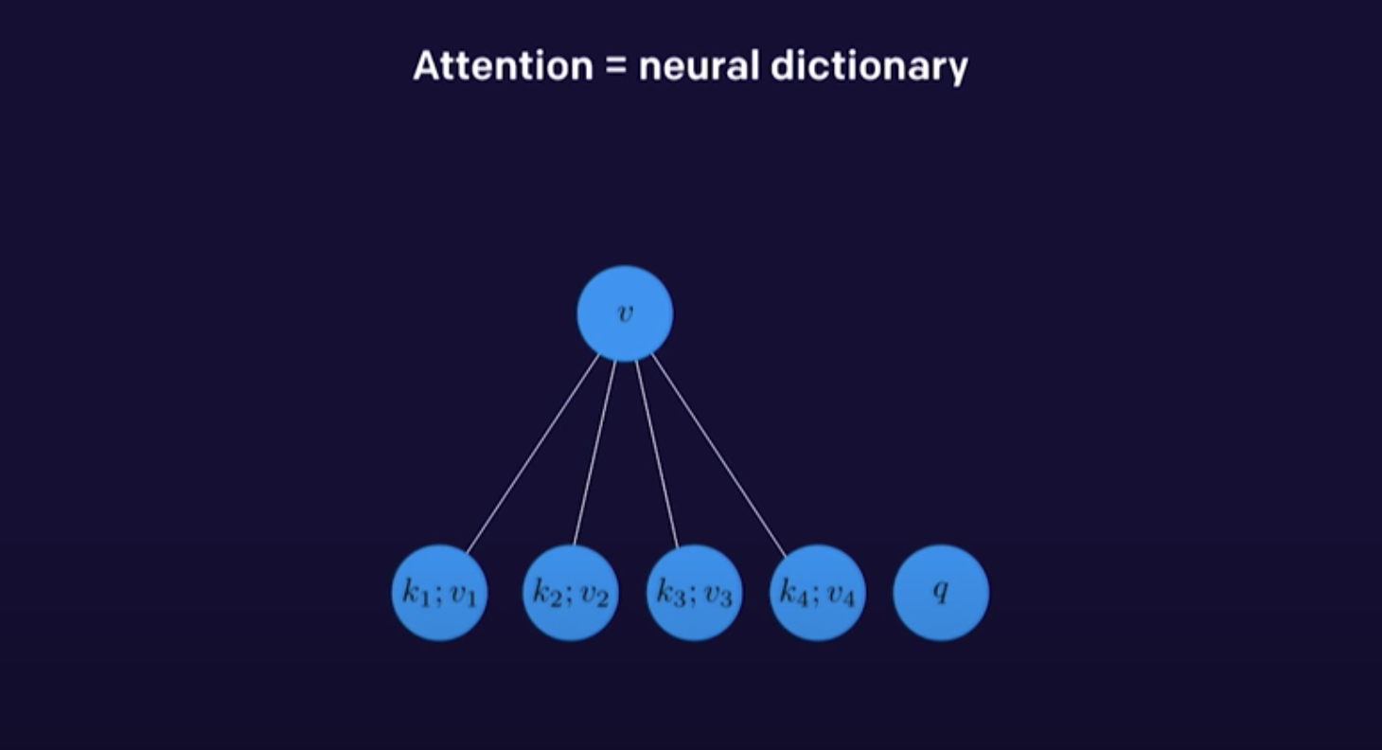
Attention Models

Slide 10
Learnings
Architectural progression LSTM ->CNN - > GPT
Performance of the encoder-decoder network degrades rapidly as the length of the input sentence increases.
LSTM is supposed to capture the long-range dependency better than the RNN, it tends to become forgetful in specific case
GPT is able to capture long range context very well

Slide 11
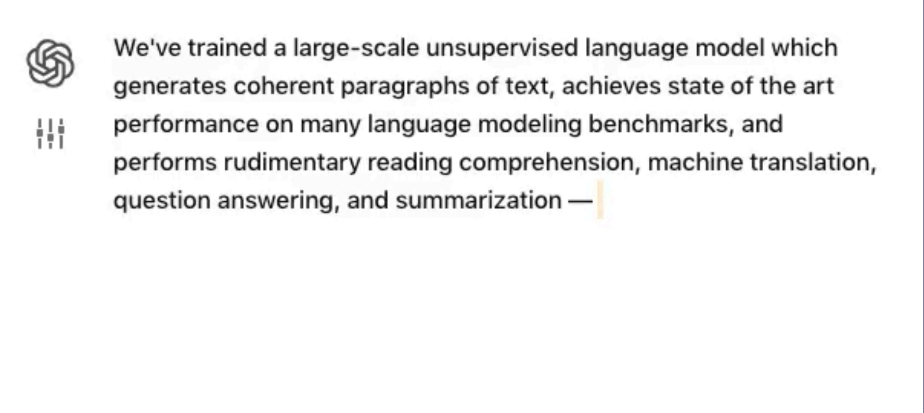
Unsupervised Learning by predicting the next word !
OpenAI GPT 2

Slide 12
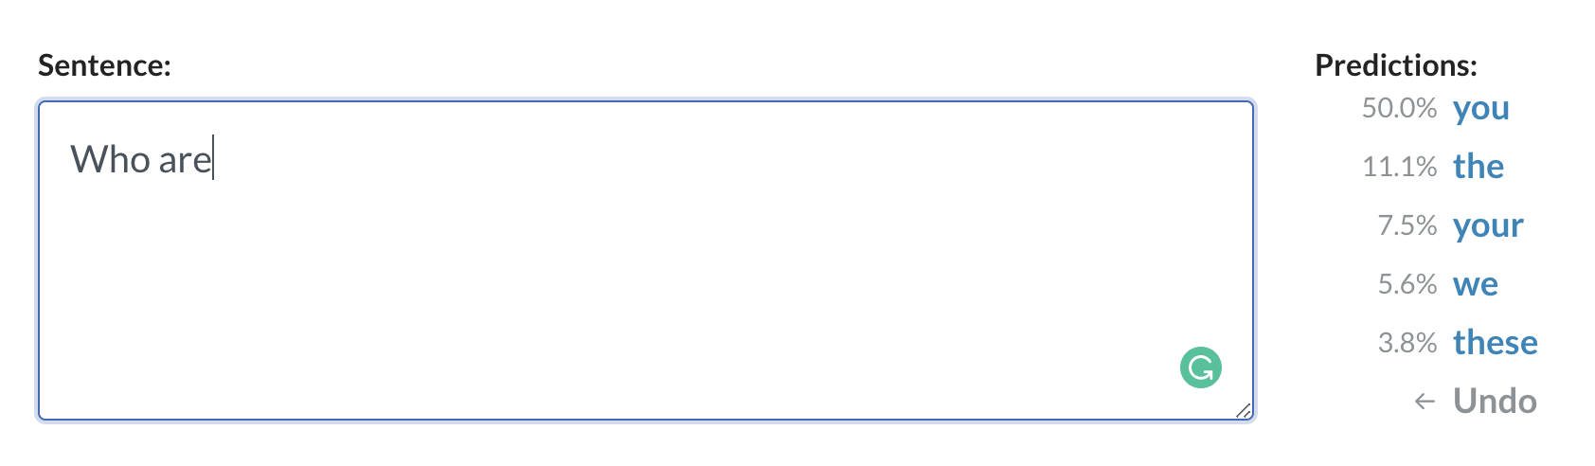
GPT 2
1.5B transformer
8B Webpages,
Webtext = High variety training data
100 voltas for a week

Slide 13
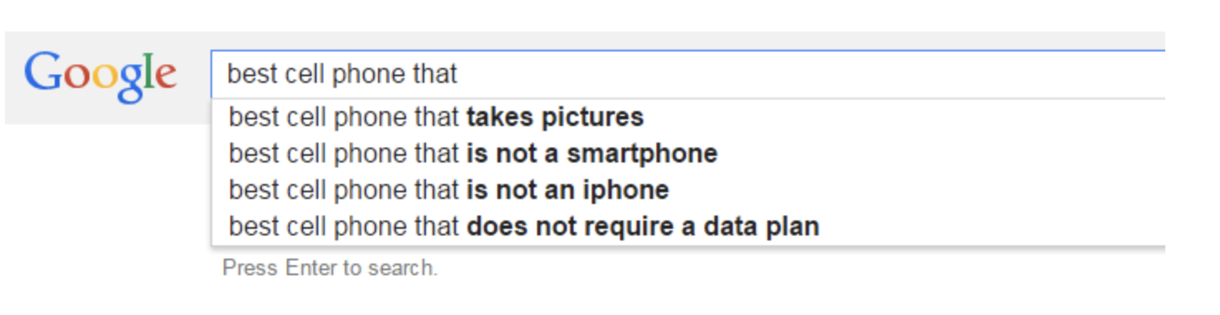
Autocomplete

Slide 14
GPT 3
Trained on 175B parameters
3.2M batch Size
It’s bigger than anything that we had before. (175B parameters, previously 1.5B)
You can use it as a product.
Most importantly — even if you give a very small input, it will figure out what you want really quickly with high accuracy.
It’s trained on ~1 trillion words and is so big that it costs ~$4.6M each time you train it.

Slide 15
AI that can write and create !
Songs,
Stories
Press releases
Guitar tabs
Interviews
Essays
Technical manuals,
Computer code
Summarize
Prescribe medication and do many other things which we haven’t even discovered yet.
Build webapps

Slide 16
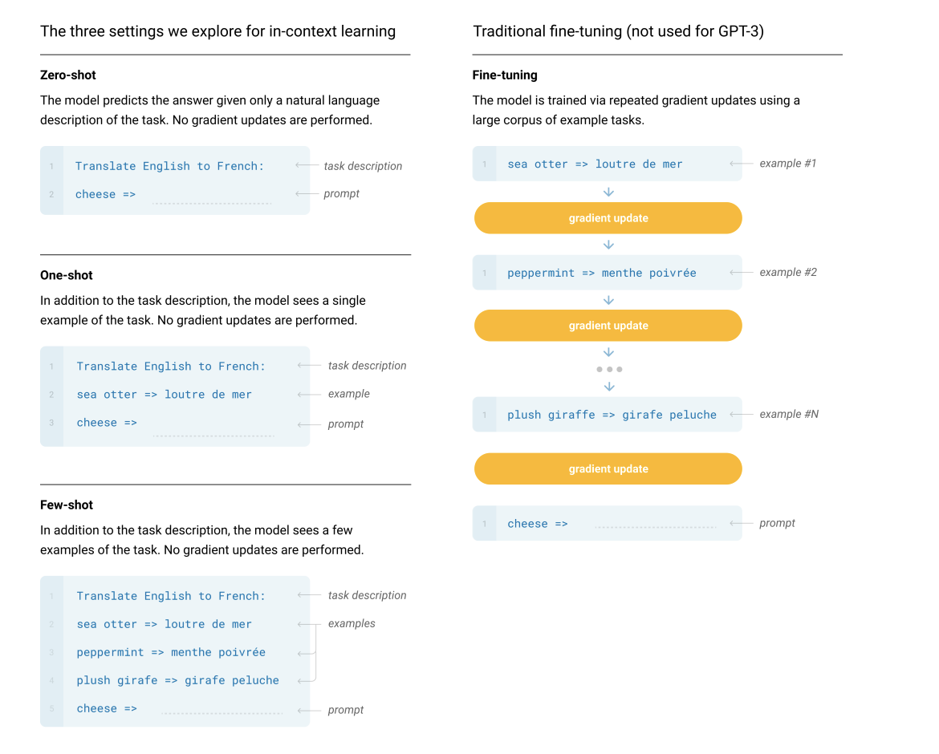
AI that can write and create !
Source https://arxiv.org/pdf/2005.14165.pdf

Slide 17
Demo!
Music Generation on Musenet- Open AI GPT- 2
Music Generation
GPT-3 examples
Gpt3demo

Slide 18
Current Research Areas
Semantic search
Summarization
Sentiment analysis
Content generation
Translation
Common Sense and Reasoning
Reading Comprehension
Question Answering

Slide 19
What’s next !
Data Creation, Data Quality, Data curation are the next frontiers
Bias and Fairness handling within Datasets will
Rise of pretrained models
Model size and computations

Slide 20



Thank You !
https://www.linkedin.com/in/chirasmitamallick/
hello@chirasmita.com
www.chirasmita.com

Slide 21
Thank you!!

